Slide 1
Analysis of English Premier League 2023/2024 Season

Slide 2
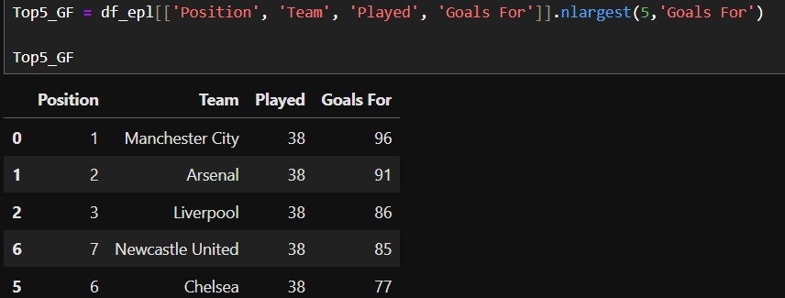
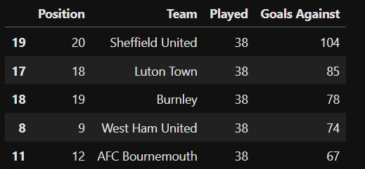
EPL Teams that scored & conceded most goals in 2023/2024 Season
Contrary to the expectation, teams that score more goals are expected to be on top of the EPL table, but Newcastle and Chelsea Football club scored a lot of goals, but they did not make the Top 5 on the table, unlike Man City , Arsenal and Liverpool whose goal scoring form helped them achieve Top 3.
On the other hand, Sheffield, Luton and Burnley are justifiably in the Bottom 3 because the 3 teams conceded a lot of goals. However, Westham and Bournemouth also conceded a lot of goals but are still able to earn the 9th and 12th position respectively on the EPL table because they were able to score back against their opponents and get away with some decent results in their outings.

Slide 3
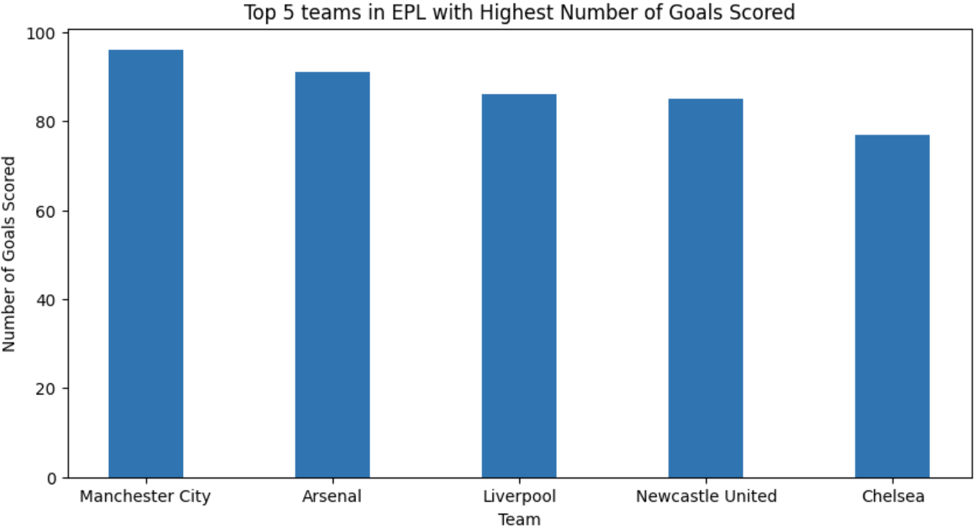
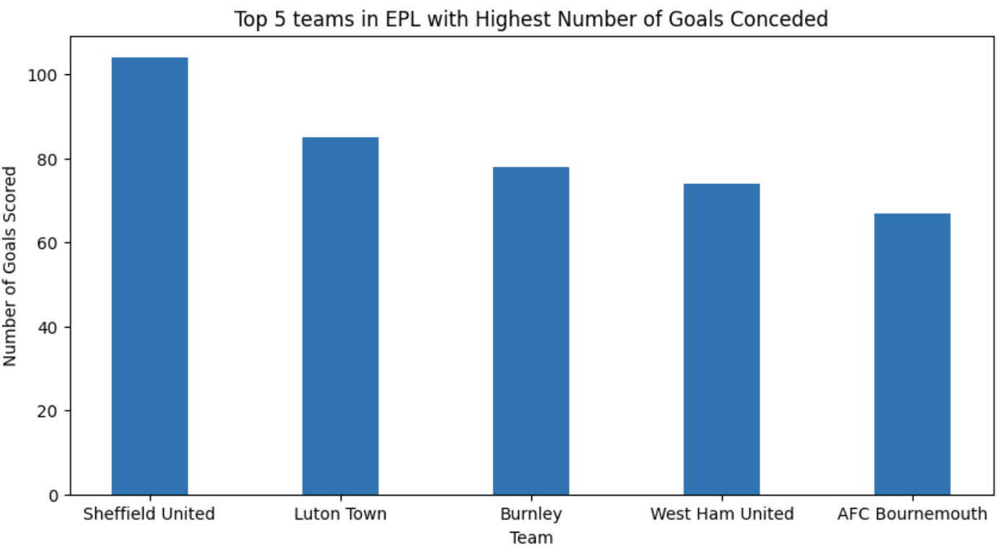
EPL Team Performance – 2023/2024 Season
5 Top Scoring Teams in the EPL
5 Teams with most Goals Conceded

Slide 4
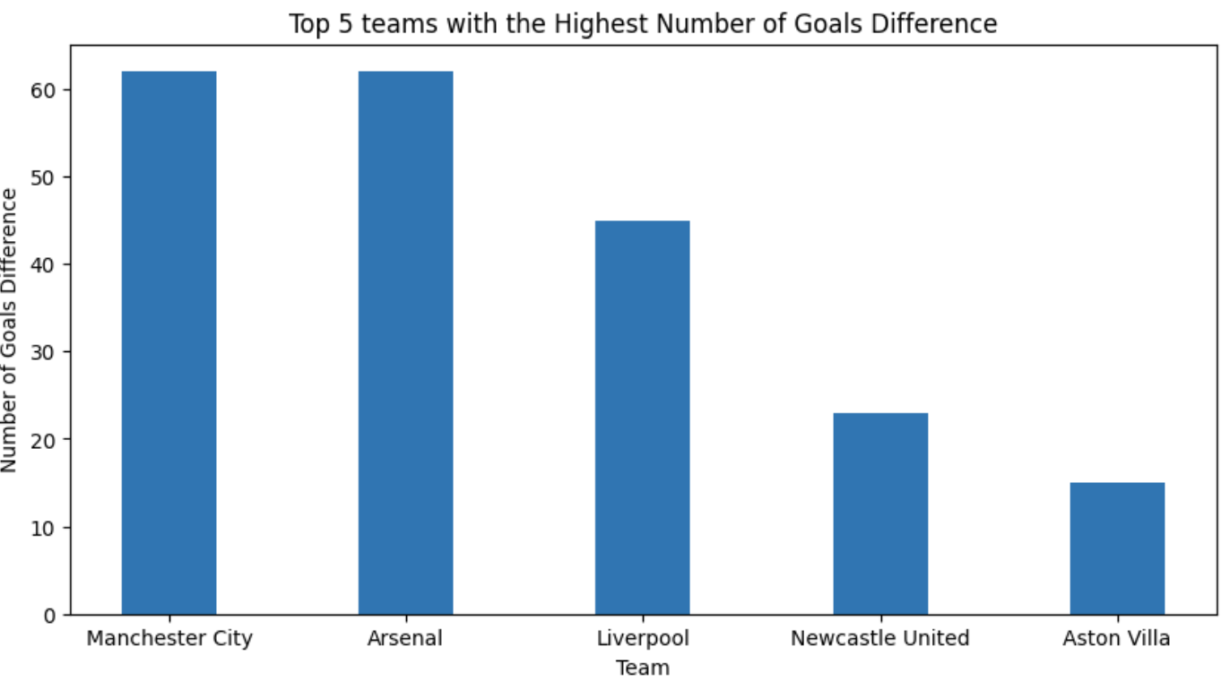
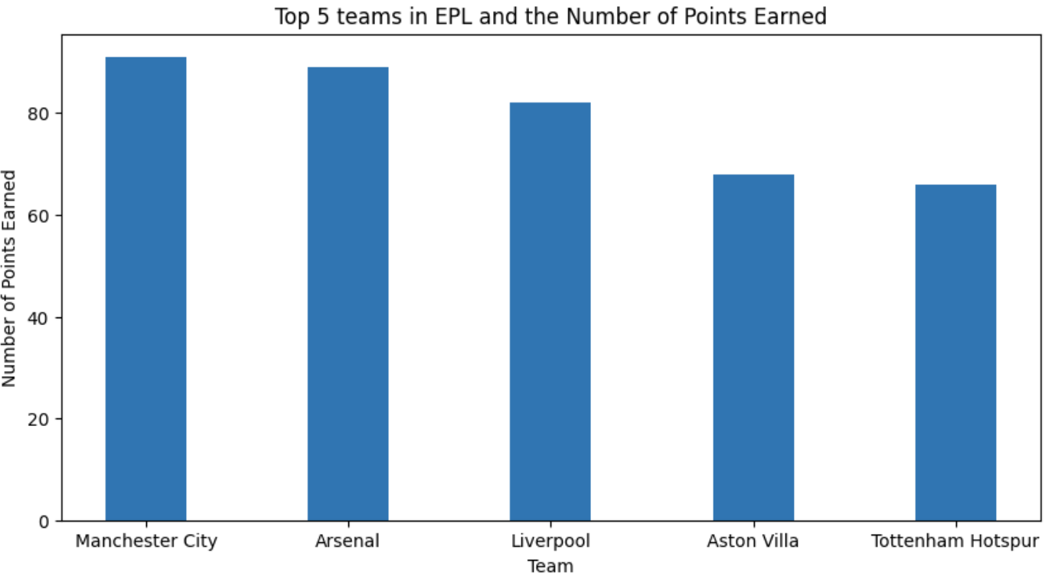
Impact of Goal Difference on Points earned
The goal difference recorded by each team does not necessarily have an impact on the total number of points earned by the teams, Newcastle & Aston Villa who had high goal difference did not make Top 5.

Slide 5
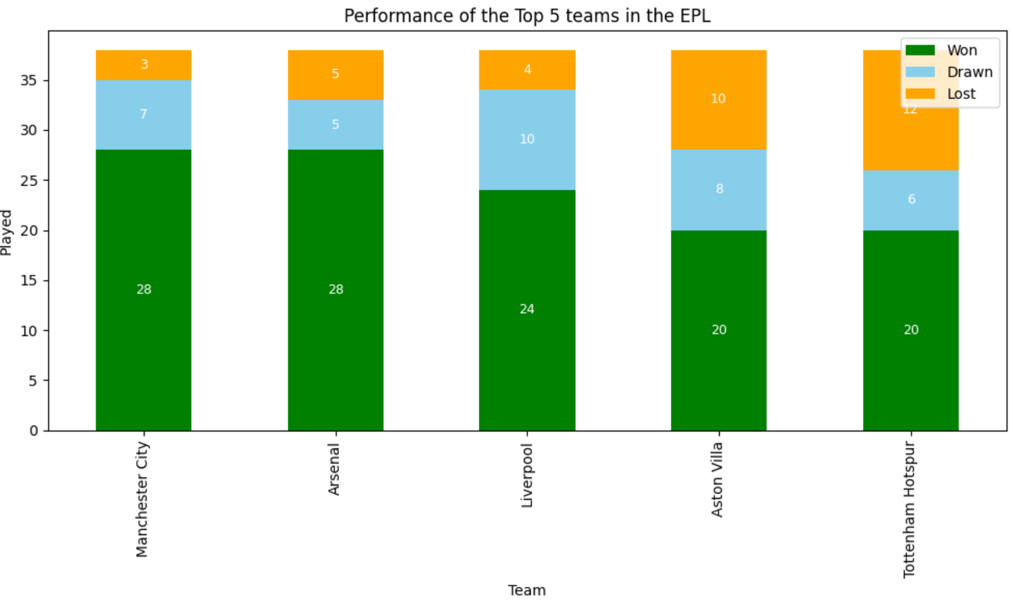
Analysis of the Top 5 Teams Performance
The chart revealed that Liverpool which occupied no.3 spot on EPL table in 2023/2024 season had the highest number of draws and the lowest number of loss after Man City than any team in Top 5. Probably they might have won the league or occupy the 2nd spot if they had converted some of their draws to a win.
On the other hand, Arsenal and Man City had equal number of wins, but Man. City was able to win the race because they lost fewer matches when compared to Arsenal. Man. City was able to get away with a draw in some of the matches they were unable to win. Similarly, Aston Villa narrowly edge out Tottenham on the Top 4 spot.

Slide 6
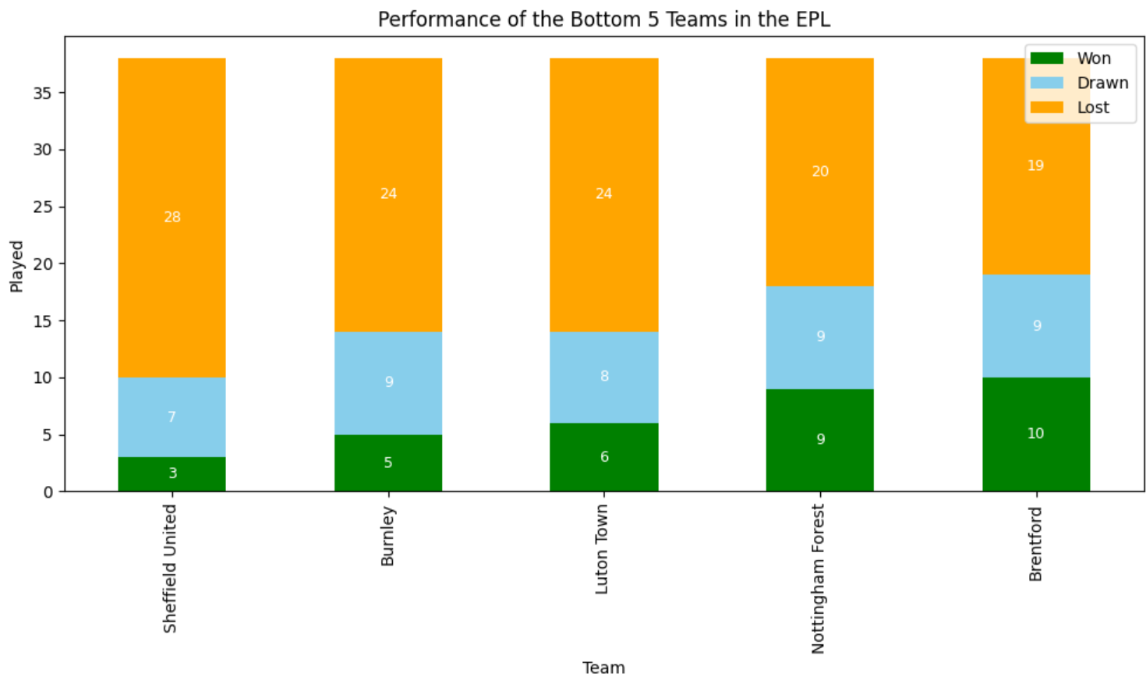
Analysis of the Bottom 5 Teams Performance
Out of the 3 bottom of the league teams relegated to Championship, Luton had a better performance than others. Even though they had equal number of loss with Burnley, they managed to get away with more draws than Burnley.
Performance of Nottingham Forest and Brentford who narrowly escaped were almost at par, but Brentford had a slightly higher number of draws than Nottingham.
Sheffield Utd had the highest number of losses, consequently they are at the bottom of the EPL table.

Slide 7
Key Take Aways
Position of teams on EPL table is purely determined by number of decent result individual teams record during their matches in terms of wins and draws and not by number of goals scored or goals conceded.
The ability of teams to keep clean sheet or concede less during their matches is key to their survival in EPL.
Top scoring teams are likely to secure a good position on EPL table

Slide 8
Thank You!!!!

